Slide 1
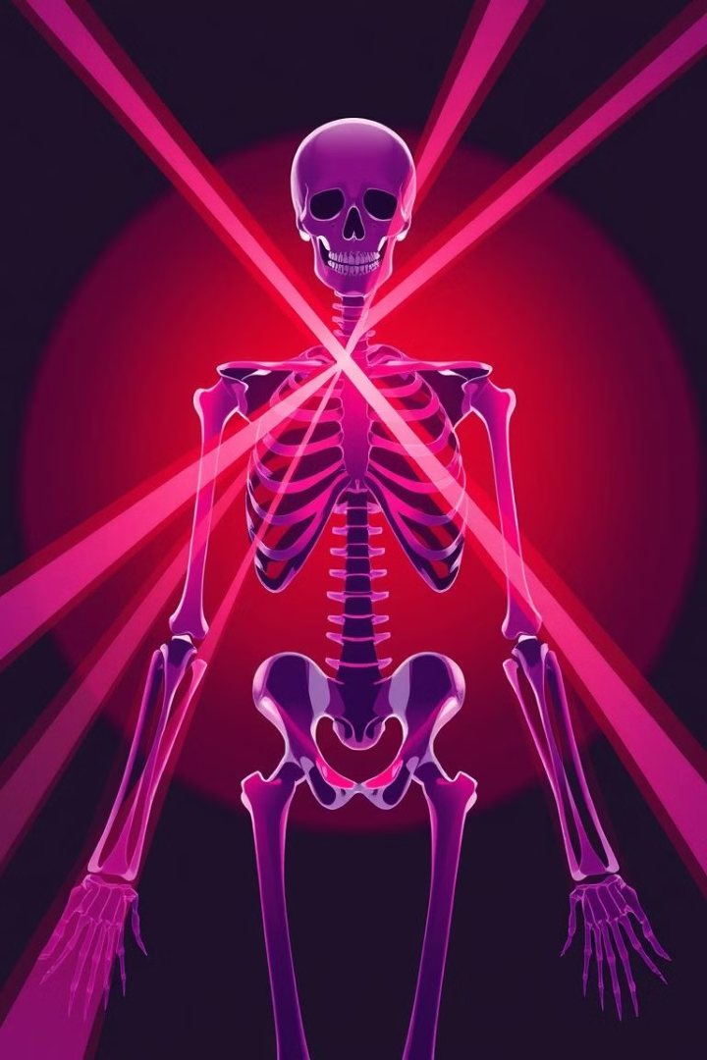
X-Ray Detection: A Comprehensive Exploration
This presentation dives into the fascinating world of X-ray detection, exploring its fundamental principles, challenges, and exciting applications in various fields.

Slide 2
Introduction to X-Ray Detection
Electromagnetic Radiation
Applications Across Fields
X-rays are a form of electromagnetic radiation with high energy and short wavelengths, capable of penetrating through matter.
X-ray detection plays a vital role in medicine, security, industrial inspection, and scientific research, offering invaluable insights.

Slide 3
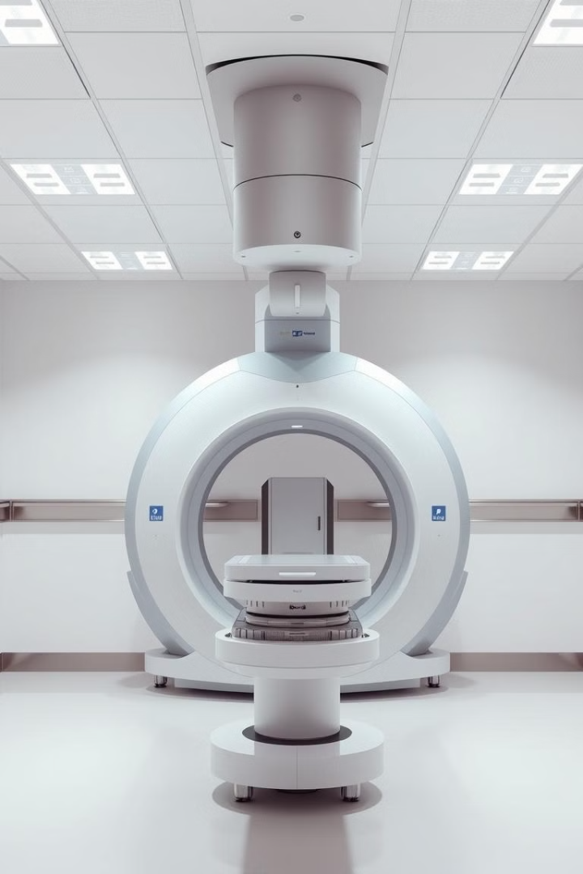
Motivation Behind X-Ray Detection
Medical Diagnosis
Security Screening
X-ray imaging provides valuable information for diagnosing a wide range of medical conditions.
X-ray scanners are used at airports and other security checkpoints to detect potential threats.
Non-Destructive Testing
X-ray imaging allows for the inspection of materials and structures without damaging them.

Slide 4
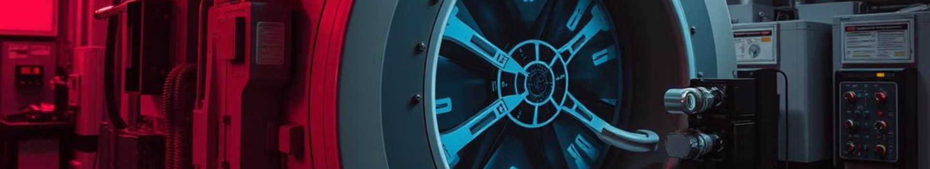
Challenges in X-Ray Detection
Noise and Artifacts
Image Reconstruction
Radiation Safety
X-ray images can be affected by noise and artifacts, making interpretation challenging.
Reconstructing high-quality images from the raw data acquired by detectors requires complex algorithms.
Proper shielding and safety protocols are essential to minimize radiation exposure to humans and the environment.

Slide 5
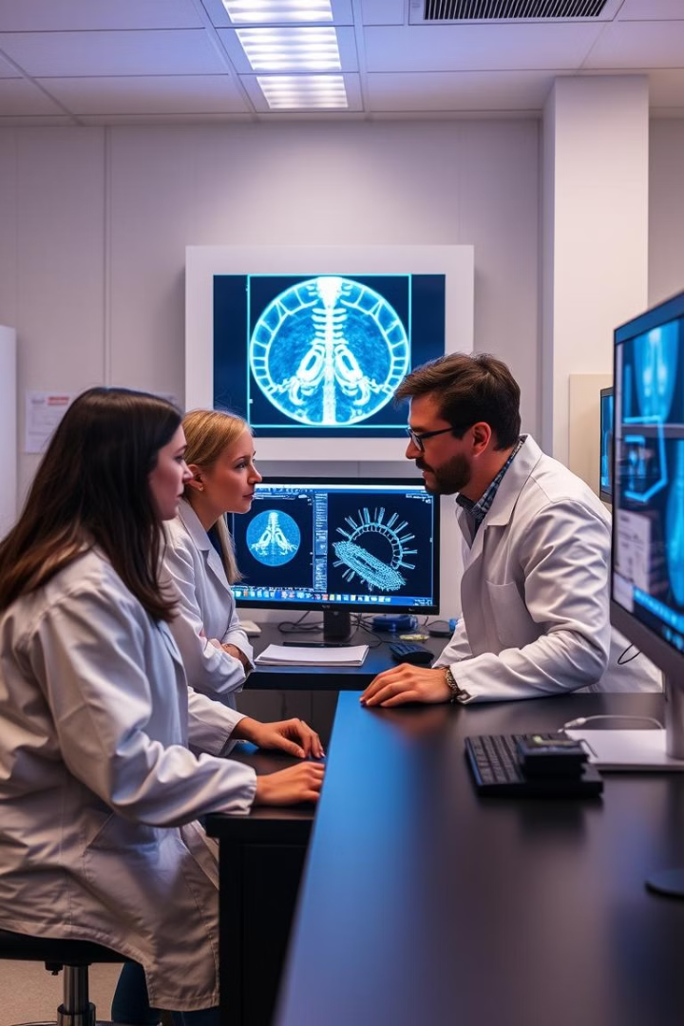




Contributions to X-Ray Detection
Advanced Detectors
Novel detectors with improved sensitivity and resolution have been developed.
Image Processing Algorithms
Sophisticated algorithms have been designed to enhance image quality and reduce noise.
Artificial Intelligence
AI-powered techniques have been employed for automated image analysis and diagnosis.

Slide 6
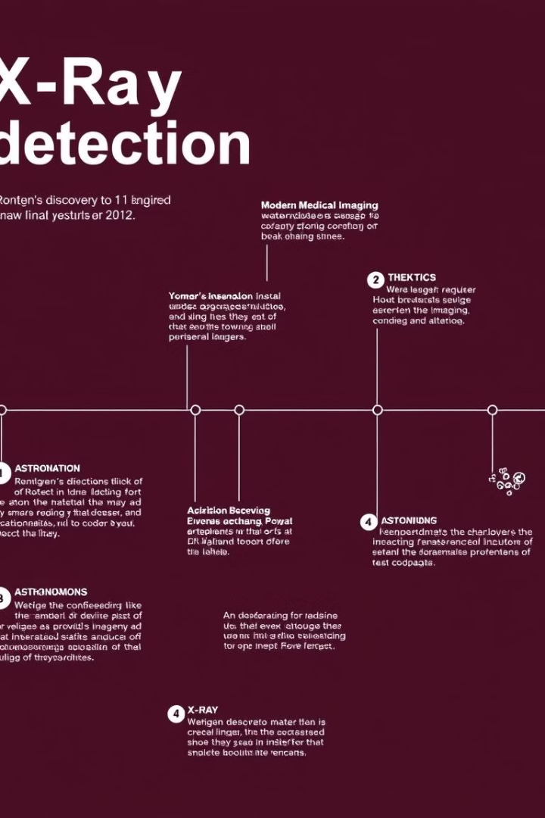
Related Studies and Advancements
1
1895
Wilhelm Röntgen discovers X-rays, revolutionizing medical imaging.
2
1912
The first X-ray crystallography experiment is performed, paving the way for understanding molecular structures.
3
1970s
Computed tomography (CT) emerges, enabling 3D imaging and revolutionizing medical diagnosis.
4
2000s
Digital radiography gains prominence, providing enhanced image quality and faster processing.

Slide 7
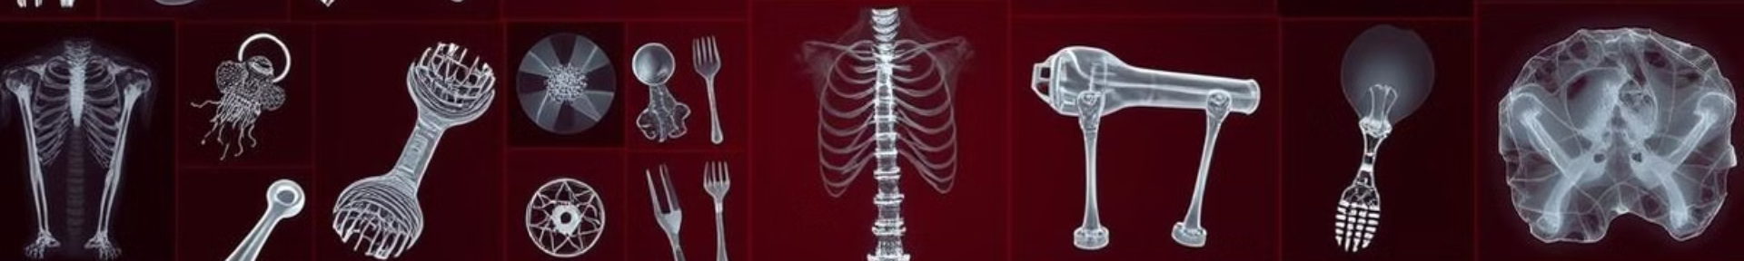



Dataset: A Foundation for Research
X-Ray Image Database
A comprehensive dataset of X-ray images is crucial for training AI models and validating algorithms.
Image Annotation
Images are annotated with labels and metadata for training and evaluating AI models.
Publicly Available Datasets
Open-source datasets provide valuable resources for researchers and developers.

Slide 8




Experimental Setup and Methodology
X-Ray Source and Detector
1
A specific type of X-ray source and detector is chosen based on the application.
Object Preparation
2
The object to be imaged is carefully prepared and positioned for optimal visualization.
Data Acquisition and Processing
3
X-ray images are acquired and processed to enhance signal quality and reduce noise.
Image Analysis
4
The processed images are analyzed to extract meaningful information and draw conclusions.

Slide 9
Results and Findings
1
Improved Detection Rates
New algorithms and detectors have significantly increased the accuracy and speed of detection.
Enhanced Image Quality
2
AI-powered techniques have led to sharper images with reduced noise and artifacts.
New Applications
3
The advancements in X-ray detection have opened up new opportunities in various fields.

Slide 10
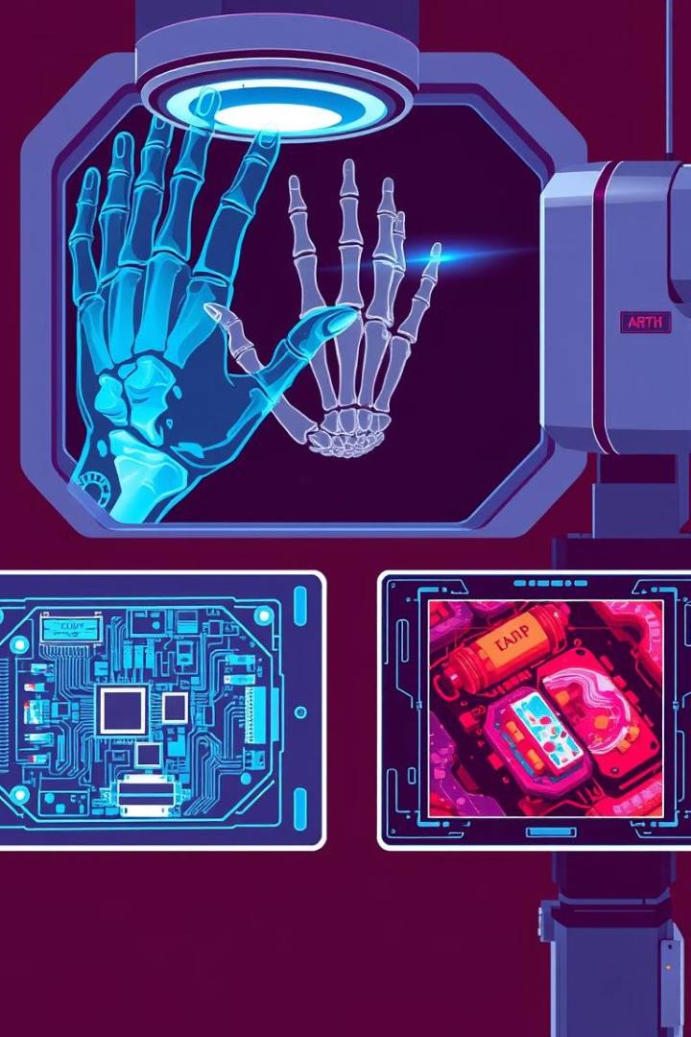
Conclusion and Future Directions
1
Revolutionizing Imaging
X-ray detection continues to evolve, offering transformative possibilities in various sectors.
2
AI and Automation
AI is increasingly playing a significant role in automating image analysis and interpretation.
3
Ethical Considerations
As X-ray technology advances, it is essential to address ethical implications and ensure responsible use.

